Slide 1
CIDM 6312-CHARTS
By
Bolaji Muyiwa

Slide 2
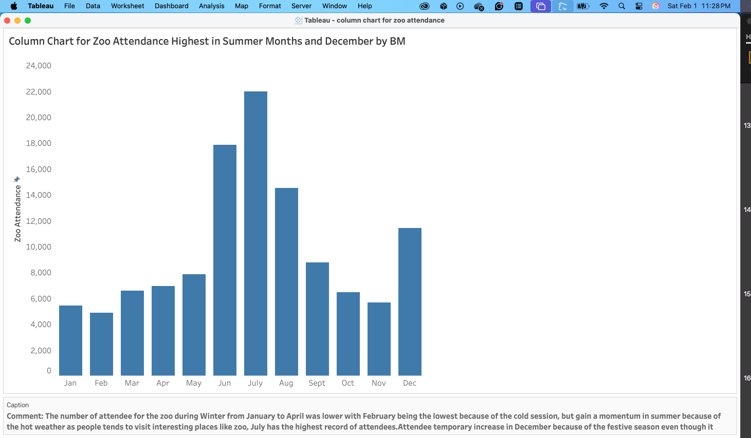
Column Chart

Slide 3
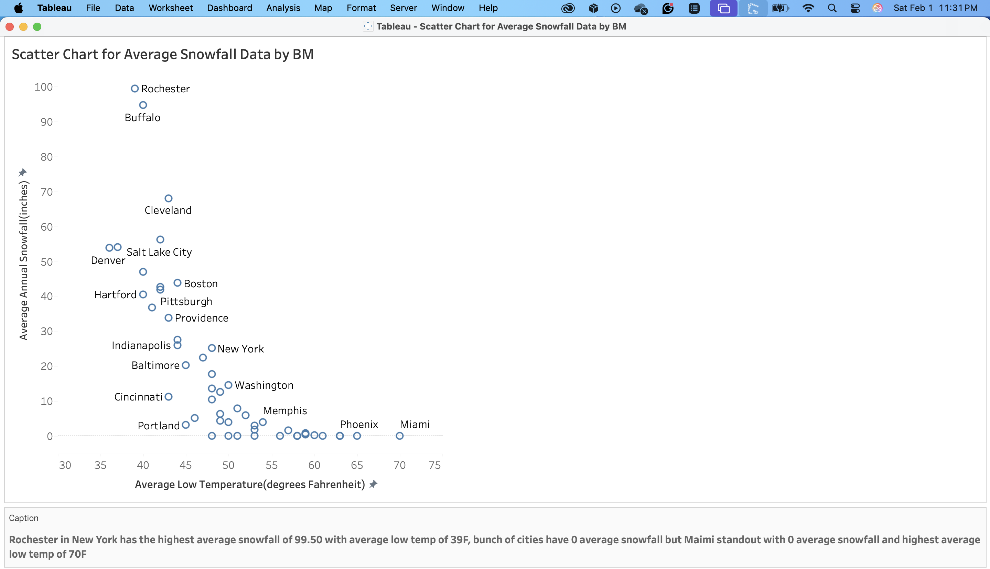
Scatter Chart

Slide 4
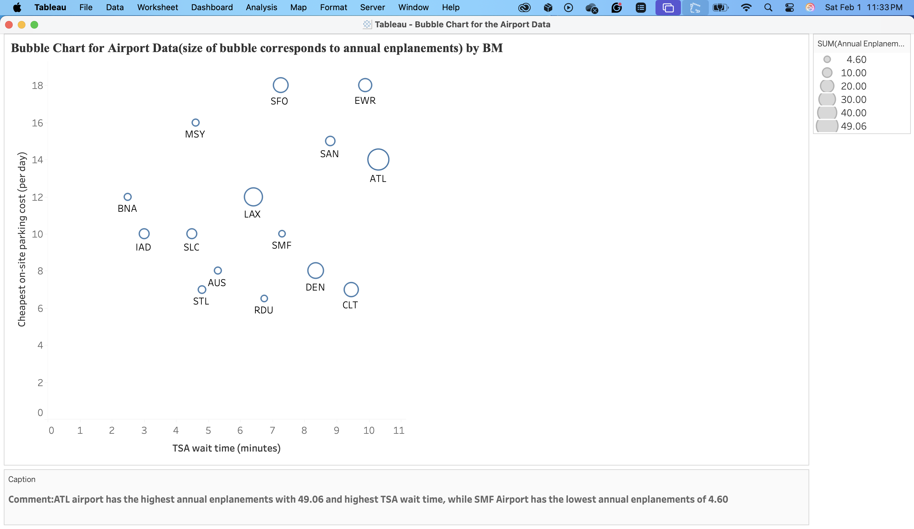
Bubble chart

Slide 5
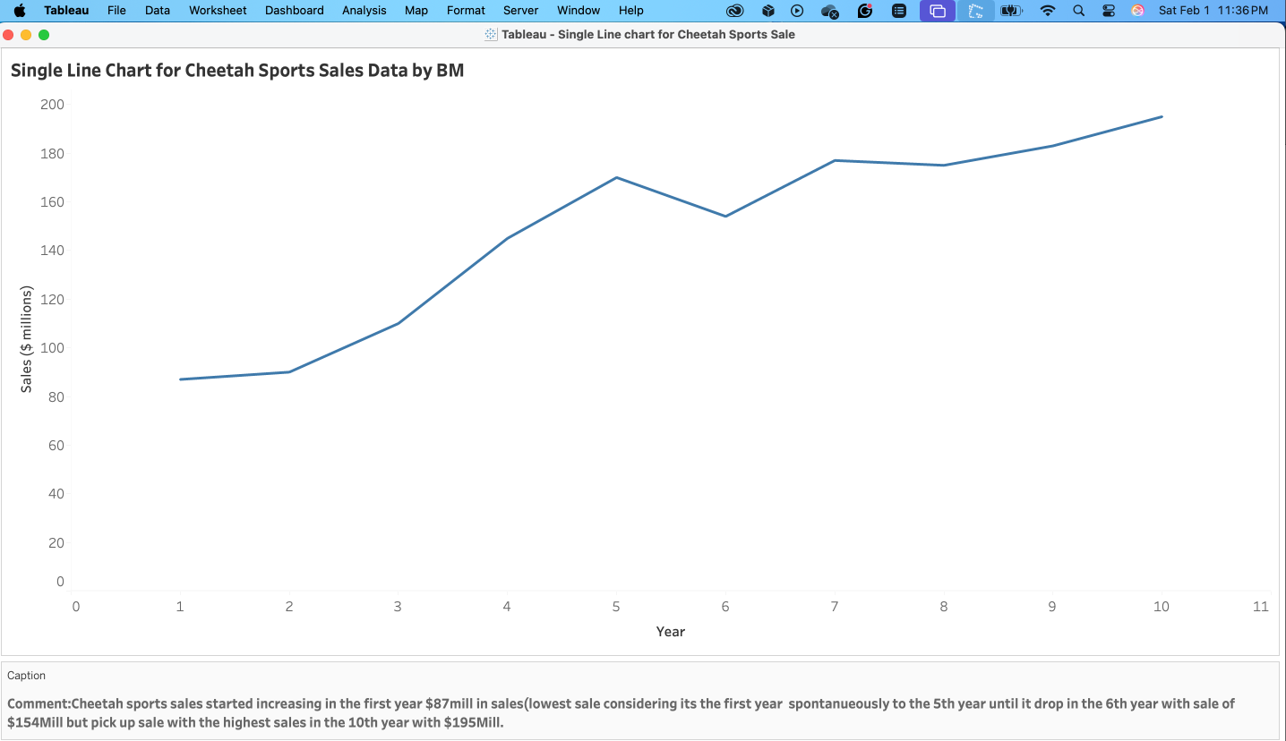
Single Line Chart

Slide 6
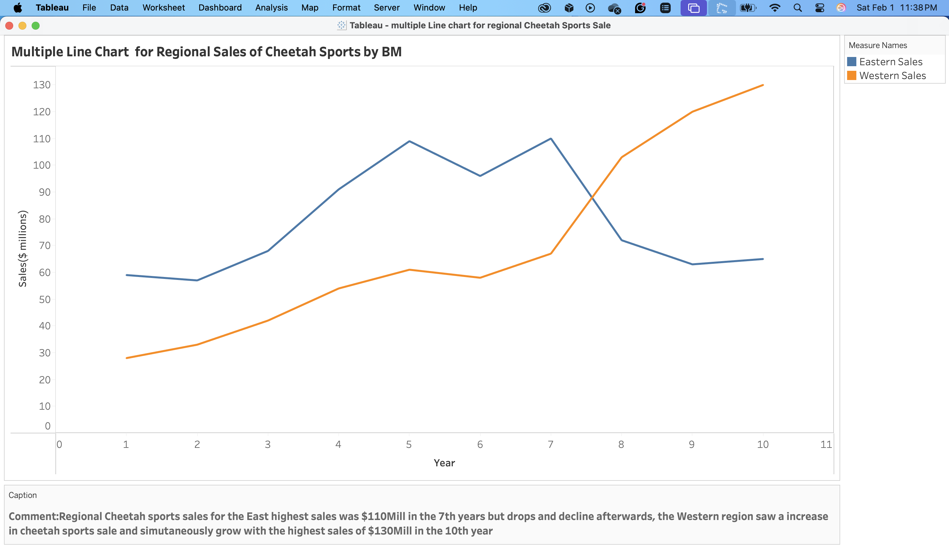

Slide 7
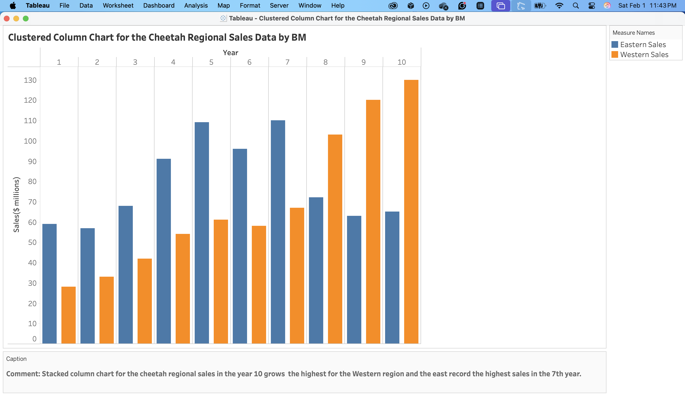
Clustered Column Chart

Slide 8
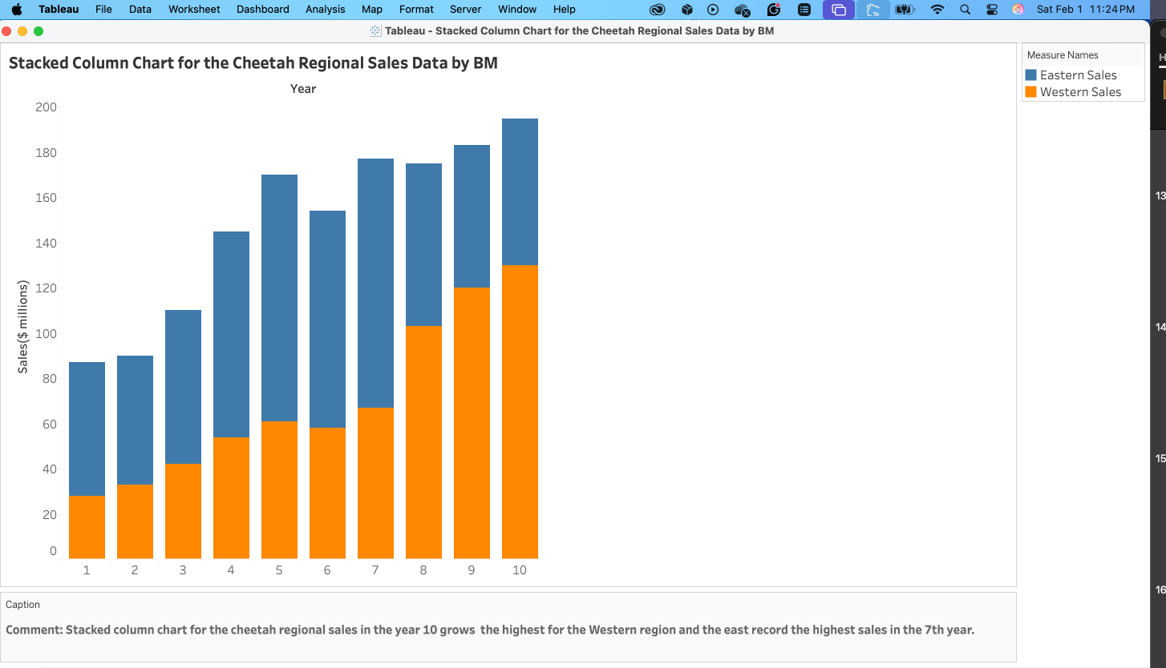
Stacked Column Chart

Slide 9
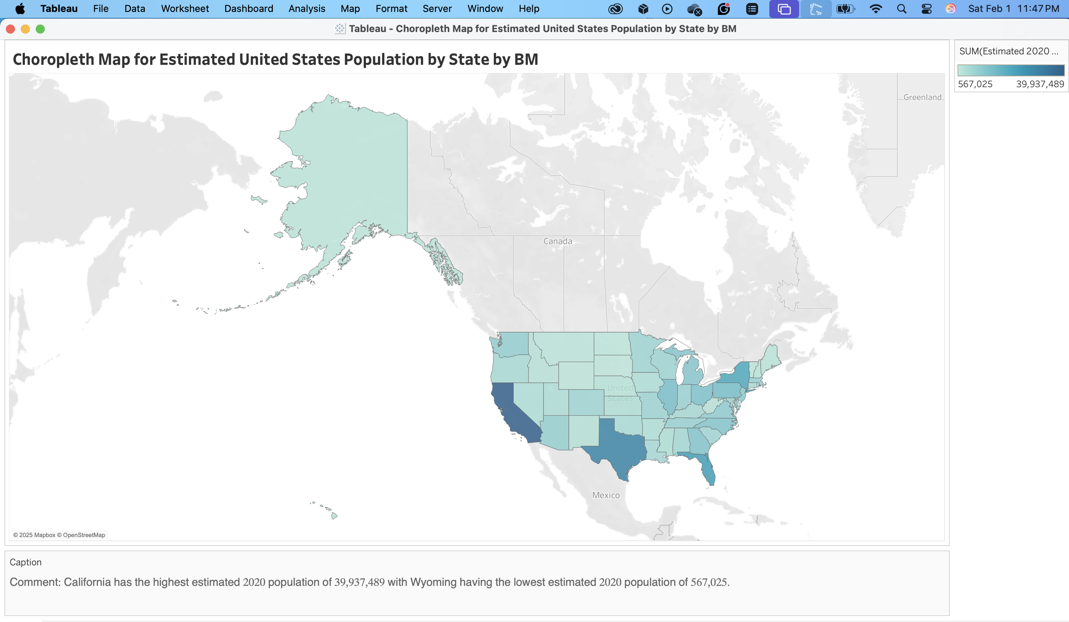
Choropleth

